Slide 1
Information Retrieval Systems
UNIT - III

Slide 2
AGENDA
Automatic Indexing: Classes of Automatic Indexing, Statistical Indexing, Natural Language, Concept Indexing, Hypertext Linkages
Document and Term Clustering: Introduction to Clustering, Thesaurus Generation, Item Clustering, Hierarchy of Clusters

Slide 3
Automatic Indexing
Automatic Indexing is the process of analyzing content (documents, web pages, etc.) to extract key semantic information and convert it into searchable terms.
The extracted information is used to create the processing tokens and the searchable data structure.

Slide 4
Automatic Indexing
An index is the data structure created to support the search strategy.
The index can be based on
full text of the item,
automatic or manual generation of a subset of terms/phrases to represent the item,
natural language representation of the item or abstraction to concepts in the item.

Slide 5
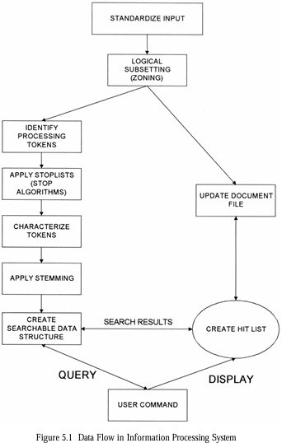
The left side of the figure including identify processing tokens, apply stop lists, characterize tokens, apply stemming and create searchable data structure is all part of the indexing process.
All systems go through an initial stage of zoning and identifying the processing tokens used to create the index.
Stop lists and stemming algorithms, are frequently applied to reduce the number of tokens to be processed

Slide 6
Statistical Indexing
Probabilistic Weighting
Vector Weighting
Simple Term Frequency Algorithm
Inverse Document Frequency
Signal Weighting
Discrimination Value
Problems with Weighting Schemes
Problems with vector Model
Bayesian Model
Natural Language
Index Phrase Generation
Natural Language Processing
Concept Indexing
Hypertext Linkages

Slide 7
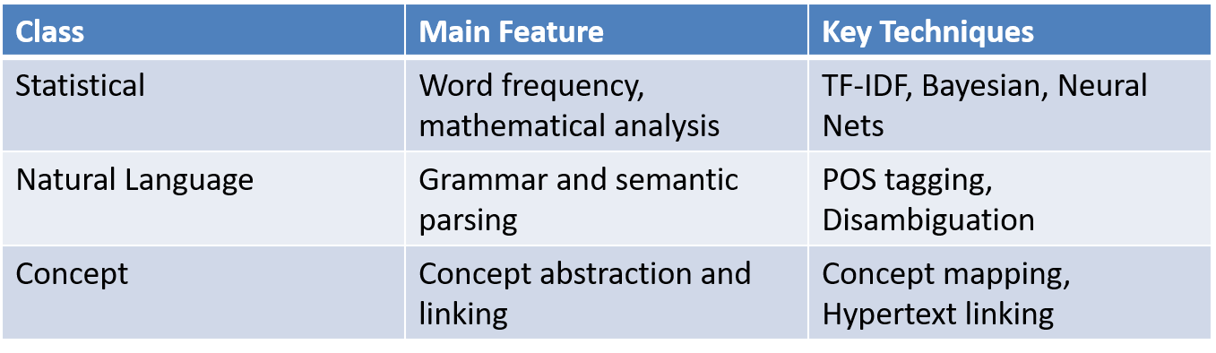
Summary

Slide 8
Statistical Indexing
Statistical Indexing is based on the idea that the more frequently a term appears, the more likely it is relevant to a user's query. This class of indexing calculates numerical values (weights, probabilities, or confidence levels) to represent how relevant a document is to a search query.
Based on frequency of words or phrases in documents
Techniques:
Probabilistic indexing
Bayesian and Vector Space approaches
Neural Networks (for concept classification)
Pros: Fast and scalable
Cons: Limited context understanding

Slide 9
Key Techniques in Statistical Indexing – Probabilistic Weighting
Calculate the probability that a document is relevant to a query.
Based on the Probability Ranking Principle (PRP) which says:
“Documents should be ranked in decreasing order of probability of relevance to the user’s query.”
It uses binary relevance assumption: a document is either relevant (1) or not relevant (0).
However, in reality, relevance is continuous—so systems often generalize the model.

Slide 10
Probabilistic Weighting
HYPOTHESIS: If a reference retrieval system’s response to each request is a ranking of the documents in the collection in order of decreasing probability of usefulness to the user who submitted the request, where the probabilities are estimated as accurately as possible on the basis of whatever data is available for this purpose, then the overall effectiveness of the system to its users is the best obtainable on the basis of that data.
PLAUSIBLE COROLLARY: The most promising source of techniques for estimating the probabilities of usefulness for output ranking in IR is standard probability theory and statistics.

Slide 11
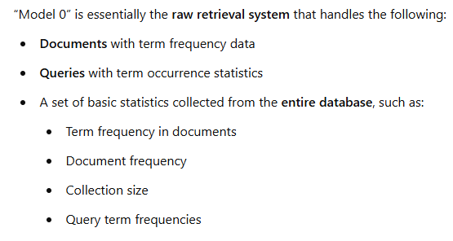
Approach Of Probabilistic Approach - Logistic Regression in IR
The approach starts by defining a “Model 0” system

Slide 12
Logistic Regression in IR
In a retrieval system there exists
query terms and document terms which have a set of attributes
from the query(e.g., counts of term frequency in the query),
from the document (e.g., counts of term frequency in the document )
from the database (e.g., total number of documents in the database divided by the number of documents indexed by the term).

Slide 13
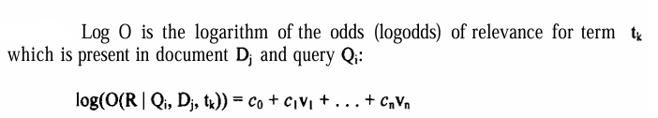
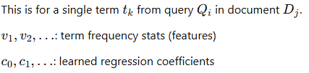
1. Estimate Log-Odds

Slide 14
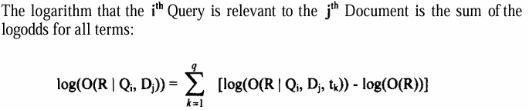

2. Aggregate Log-Odds Across All Query Terms
Now sum the effects of all query terms:

Slide 15
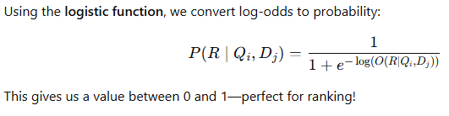
3. Convert Log-Odds to Probability

Slide 16
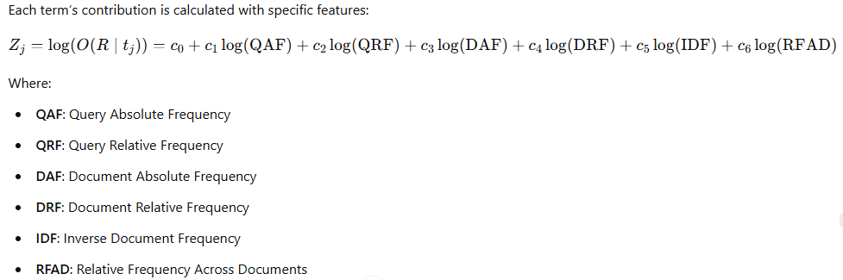
4. Feature-Based Model (Logistic Regression)

Slide 17
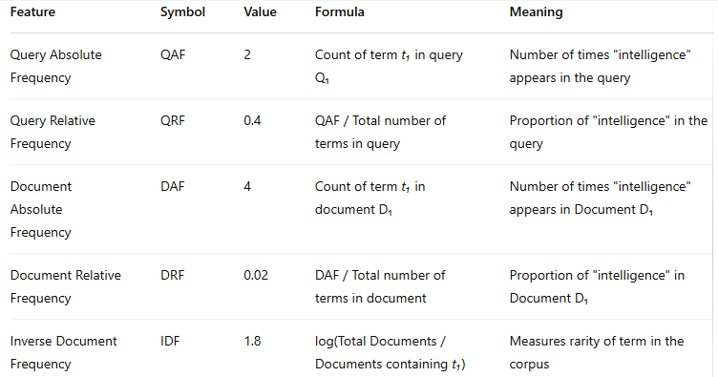


Slide 18
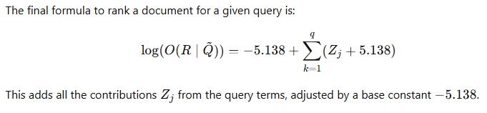
5. Final Ranking Formula

Slide 19
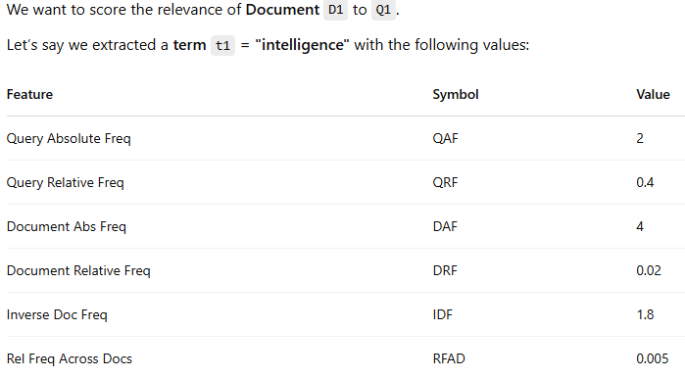
Example For Probabilistic Weighting

Slide 20
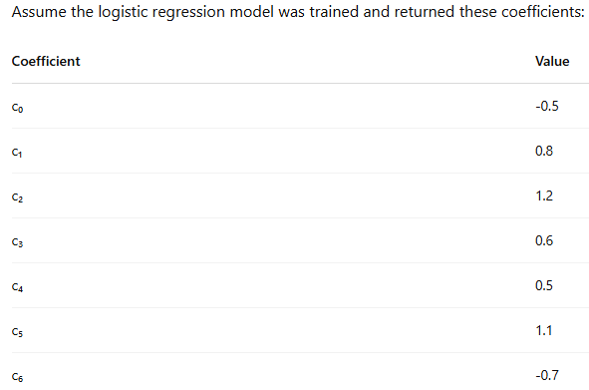

Slide 21
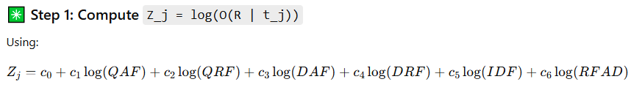
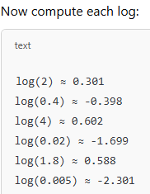

Slide 22
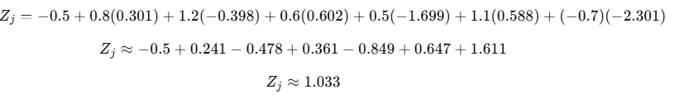

Step 2: Convert Log-Odds to Probability

Slide 23
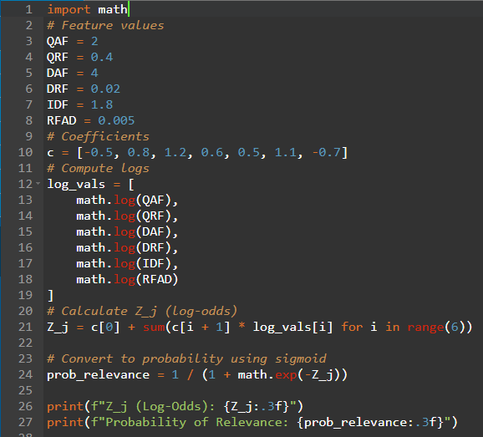


Slide 24
Vector Weighting
The semantics of every item are represented as a vector.
In Information Retrieval:
A document (or an item) is transformed into a vector of numbers.
Each position in the vector corresponds to a term (e.g., "Petroleum", "Mexico", "Oil", etc.).
Each value in the vector represents how important that term is in the document.
There are two approaches to the domain of values in the vector:
binary
weighted.

Slide 25
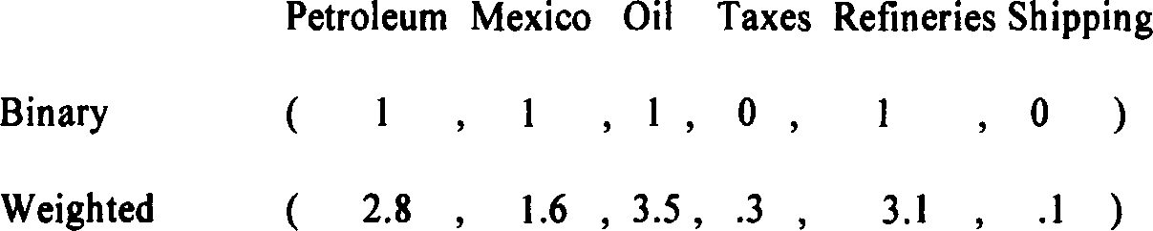
Vector Weighting
Under the binary approach, the domain contains the value of 1s or 0s, with one representing the existence of the processing token in the item.
A value of 1 means the term is present in the document.
A value of 0 means the term is absent or not important enough.
In the weighted approach, the domain is typically the set of all real positive numbers.
Reflects degrees of relevance, not just presence/absence.

Slide 26
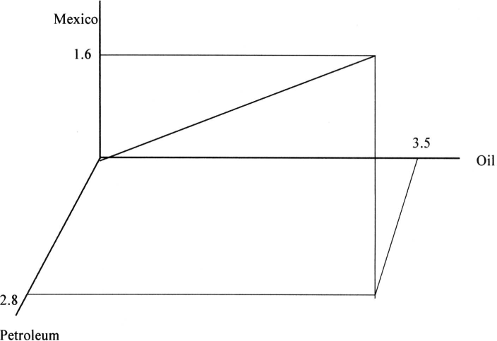
Vector Weighting
This figure shows a 3D coordinate space with just 3 dimensions:
X-axis: Petroleum
Y-axis: Mexico
Z-axis: Oil
The document vector is a point in this space: (2.8, 1.6, 3.5)
Each document is represented as such a point or arrow in an n-dimensional space.

Slide 27

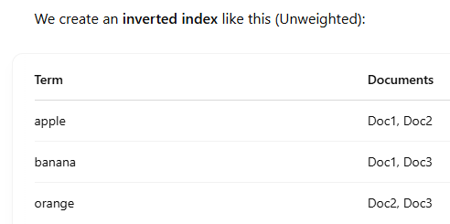
Unweighted Indexing

Slide 28
Weighted indexing
Weighted indexing considers the frequency or significance of terms in the documents, commonly using TF-IDF (Term Frequency-Inverse Document Frequency) or similar weighting schemes.

Slide 29

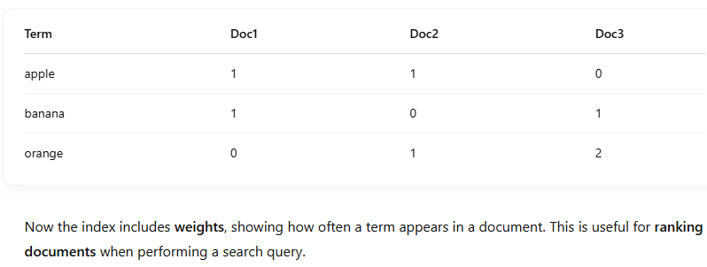
Weighted indexing

Slide 30
Normalize Term Frequency (TF)
When you count how many times a term appears in a document (called term frequency, or TF), you might give unfair advantage to long documents. So, we normalize TF to balance things.

Slide 31

Vector Weighting - Simple Term Frequency Algorithm
Basic Formula for TF Normalization:
Where:
TF: Term frequency in the current document
average TF: Average term frequency across all documents

Slide 32
Vector Weighting - Simple Term Frequency Algorithm
Pivoted Length Normalization
Where:
Slope: controls how aggressively you adjust for length
Pivot: a central reference value (e.g., Average document length)
Old normalization: usually the term frequency component

Slide 33

Vector Weighting - Simple Term Frequency Algorithm
Final Combined Formula:
Numerator normalizes the term frequency using log scale
Denominator adjusts the TF using the slope and the document length
The pivot is used to balance short and long documents
TF score =

Slide 34
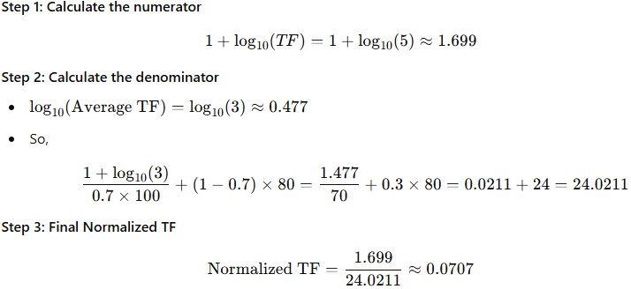
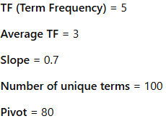
Example - STFA

Slide 35

Vector Weighting - IDF (Inverse Document Frequency)
IDF (Inverse Document Frequency) measures how unique or rare a term is across all documents in a corpus. It is part of the TF-IDF (Term Frequency-Inverse Document Frequency) weighting scheme, which is widely used to rank documents based on their relevance to a query.
Where:
TF_{ij}: Term frequency of term j in document i
n: Total number of items/documents
IF_{j}​: Number of items/documents containing term j

Slide 36
Vector Weighting - IDF (Inverse Document Frequency) - Example
Total items (n) = 2048
Terms & Frequencies:
"oil": appears 4 times in the item, found in 128 documents
"Mexico": appears 8 times, found in 16 documents
"refinery": appears 10 times, found in 1024 documents

Slide 37
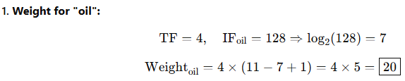
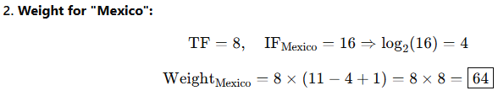
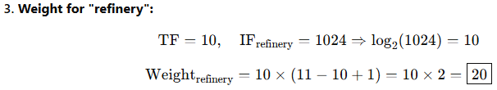

Slide 38
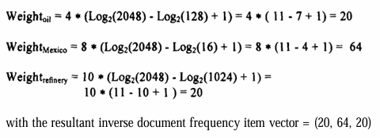

Slide 39
Signal Weighting
Can be used to improve term weighting in information retrieval systems (IRS) beyond standard inverse document frequency (IDF).
The signal weighting method enhances precision in search results by considering how a term is distributed across documents, not just how many documents contain it. This adds a statistical depth using shannon's information theory to standard retrieval models.
Information theory—specifically shannon's entropy

Slide 40
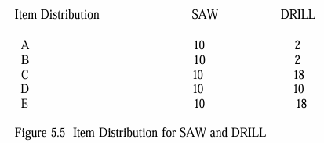
Signal Weighting - Example
The item distribution of two terms — SAW and DRILL — across five documents (A to E).

Slide 41
Signal Weighting - Example
SAW appears exactly 10 times in every document → very uniform distribution.
DRILL appears unevenly: low in A & B, high in C & E → non-uniform distribution.

Slide 42
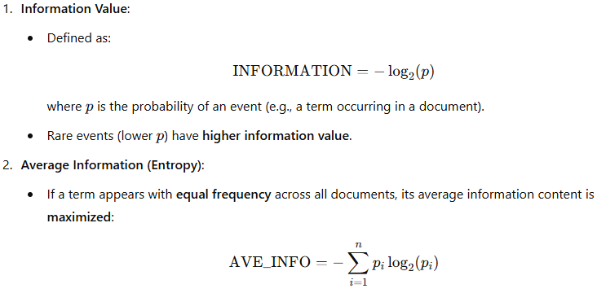
Signal Weighting – Example – Weight Calculation

Slide 43
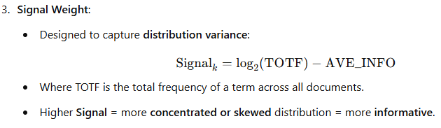
Signal Weighting – Example – Weight Calculation

Slide 44
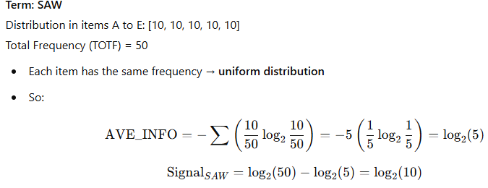
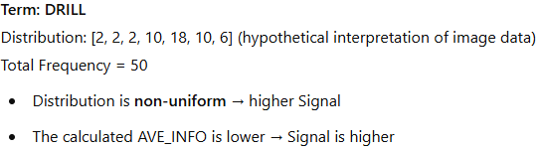

Slide 45
Discrimination Value Weighting
The goal of this weighting approach is to assign importance to terms that help distinguish (discriminate) between documents/items in a collection. The Discrimination Value (DISCRIM) measures how much a term contributes to differentiating items.

Slide 46
Discrimination Value Weighting – Steps to calculate weighting
Step 1: Compute DISCRIMᵢ
AVESIM = average similarity between all items in the database.
AVESIMᵢ = average similarity when term i is removed from all items.

Slide 47

Discrimination Value Weighting – Steps to calculate weighting
Step 2: Compute Final Term Weight
TFᵢₖ = Term frequency of term k in document i.
DISCRIMₖ = Discrimination value for term k.

Slide 48
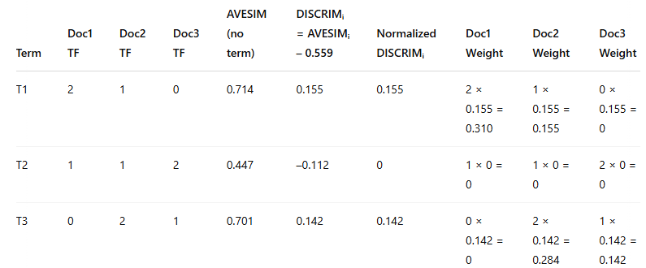
Discrimination Value Weighting - Example

Slide 49
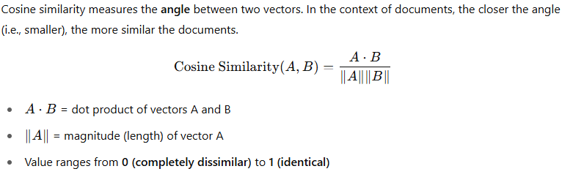
Discrimination Value Weighting - Cosine Similarity

Slide 50
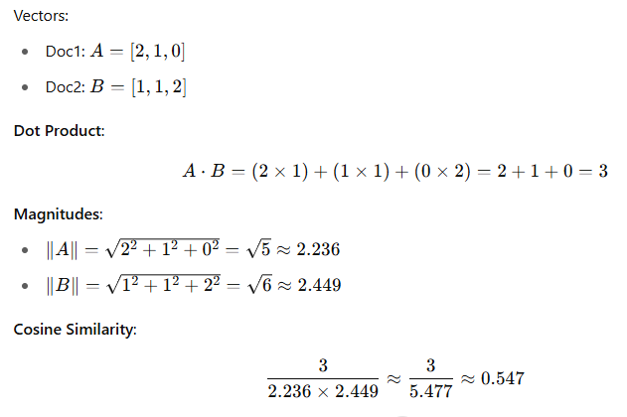
Discrimination Value Weighting - Cosine Similarity

Slide 51
Problems With Weighting Schemes
Weighting schemes (like inverse document frequency and signal) depend on token distributions in the database.
Since databases are dynamic (with frequent additions and some deletions/updates), the values used for weighting change over time.
This presents a challenge in maintaining consistent and accurate weightings.

Slide 52
Three Main Approaches to Handle Changing Weight Factors:
Aspect | Approach 1: Rebuild Periodically | Approach 2: Threshold-Based Update | Approach 3: Dynamic Calculation
Method | Use current values; recalculate entire database periodically | Use fixed values; update only when change threshold is exceeded | Store invariant values; compute weights during search
Overhead | Low during runtime; high during rebuild | Moderate; distributed over time | High computation per query (minimal if using inverted files)
Accuracy | Medium – fluctuates over time | High – stable until major changes | Very High – always current
Best For | Simpler systems, infrequent updates | Balanced efficiency and accuracy | High-accuracy systems or small databases
Downside | Costly rebuilds for large DBs | Complexity in tracking changes | Slower search times without optimization

Slide 53
Problems With the Vector Model
Issue Category | Problem Description | Example / Explanation
Dynamic Databases | Weighting factors can become inaccurate as the database content changes dynamically. | Term importance may shift over time, but the model doesn't adapt automatically.
Multiple Topics in a Document | The model cannot differentiate between distinct topics discussed in the same document. | A document discussing “oil in Mexico” and “coal in Pennsylvania” may match “coal in Mexico” incorrectly.
Lack of Term Association | Terms are treated independently; no correlation or linkage between related terms (no precoordination). | “Coal” and “Mexico” are scored independently, even if unrelated in context.
No Positional Information | Cannot perform proximity searches (e.g., term A within 10 words of term B). | Positional relationships between terms are not stored.
Scalar Value Limitation | Each term is assigned only one scalar value per document — no detail about term location or section. | Can't distinguish where the term appears in the document.
Subset Searching as a Fix | Searching within parts (subsets) of a document can improve precision by focusing on specific topics. | Helps isolate sections that match a search query more accurately.

Slide 54

Bayesian Model
Bayesian model uses conditional probabilities to estimate how relevant an item is, given a query.
The formula used is:
The probability that a document (doc_{i}) is relevant (REL) given a query (query_{j}).

Slide 55
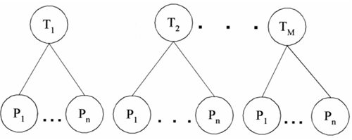
How It Works
In the diagram:
Circles marked T₁, T₂, ..., Tₘ = topics.
Circles marked P₁, P₂, ..., Pₙ = observed processing tokens.
The lines show probabilistic relationships between tokens and topics.
Creating an index is about capturing semantic meaning using topics.
A Bayesian network helps assign weights to tokens and topics for this purpose.

Slide 56
Binary Independence
The model assumes independence between:
Topics.
Processing tokens.
Each topic/token exists independently of others.
But this is rarely true in real data.
Topics like "Politics" and "Economics" can be related.
Tokens related to one concept often appear with others.

Slide 57
Solutions to Independence Violation
Two ways to handle dependencies:
Ignore dependencies (assume mutual independence):
Easier and commonly used.
Accept small error margins.
Model dependencies explicitly by extending the Bayesian network:
Introduce Independent Topics (ITs) above the topic layer.
Add Independent Processing Tokens (IPs) below the processing tokens layer.
Compensates for the real-world co-occurrence of topics and tokens.

Slide 58
How it works
Statistical methods:
Use proximity of words (e.g., how close words appear together).
Example: Phrases like "venetian blind" and "blind Venetian" might look the same statistically (they’re adjacent), but semantically they are very different.
Semantic processing:
Goes deeper by understanding the meaning and structure of sentences.
Recognizes that "venetian blind" (a window covering) ≠ "blind Venetian" (a visually impaired person from Venice).
Generates phrases or even thematic representations (ideas, not just words).

Slide 59
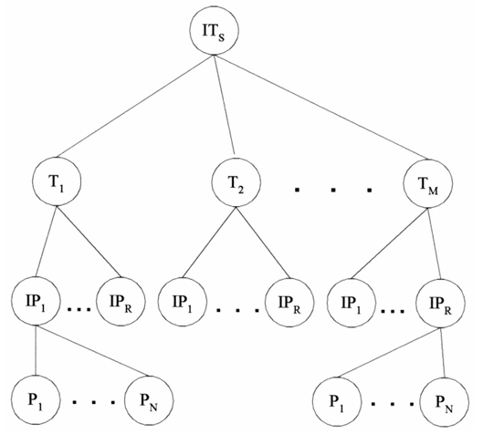
The image is likely a hierarchical model related to NLP indexing:
Top level (ITs) could represent the item or system being indexed.
The next level (T₁ to T_{M}) might be topics or thematic categories.
Below that, IP₁ to IP_{R} might represent index phrases derived from processing.
At the bottom, P₁ to P_{N} could be individual phrases or words.
It shows how complex semantic processing builds up from base phrases to structured thematic indexes.

Slide 60
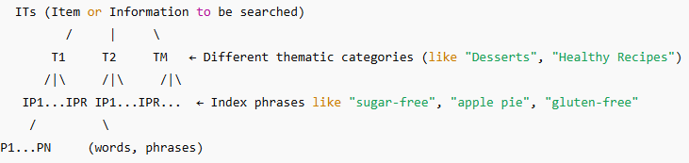
Example

Slide 61
Example - Explanation
Search Query | Statistical Search Finds | NLP-enhanced Search Finds
“How to make apple pie without sugar” | “apple pie with sugar”, “sugar recipes” | Sugar-free apple pie recipes
“Symptoms of COVID in children” | Pages with “COVID”, “symptoms”, “children” separately | Articles about COVID symptoms in kids
“Best sci-fi movies with time travel” | Any sci-fi movie mention | Movies that are both sci-fi & time-travel

Slide 62
Natural Language
The primary goal of NLP is to:
Improve the accuracy (precision) of search results.
Reduce false hits, meaning users don’t have to go through irrelevant results.

Slide 63
Advanced NLP
Thematic Representations:
These are more complex than phrases.
They capture concepts and how they relate to each other.
One way to represent this: Concept-Relationship-Concept triples
(Example: "doctor – treats – patient").

Slide 64
Natural Language Processing - Steps
Lexical Analysis & Term Phrases
Higher-Level Linguistic Processing
Mapping Tokens to Subject Codes
Text Structuring
News Schema Model
Classifying Intent & Identifying Topical Statements
Identifying Relationships Between Concepts
Relationship Weighting
Final Data Structures and Retrieval

Slide 65
Example : DR-LINK (Document Retrieval through Linguistic Knowledge) - Textwise System
Lexical analysis & term phrases
Basic aspects of the text, like verb tense, plurality, and part of speech.
Term phrases are important for creating a searchable index
Higher-level linguistic processing
Relationship concept detectors, conceptual graph generators, and conceptual graph matchers are functional components in this NLP system.
The system aims to detect semantic relationships (meaning between words or concepts) and discourse-level relationships (meaning how different parts of the text relate to each other in terms of argument, story, or description).

Slide 66
Mapping tokens to subject codes
Mapping tokens (individual words or phrases) in the document to subject codes as defined by a dictionary like the longman’s dictionary of common english (LDOCE).
Disambiguation (e.g., "bank" as a riverbank vs. financial bank) is performed using statistical relationships between terms and the ordering of subject codes to determine which category a token most likely belongs to.
Text structuring
The system to assign higher weight to terms that belong to certain categories when performing a search.
Also includes identifying topic statements, such as determining if the text is talking about the past, present, or future.
Evaluation (opinions) , Main event (basic facts) , Expectations (predictions)

Slide 67
News Schema Model
The system uses a general model to understand the predicted structure of texts.
a schema consisting of different components like Circumstance, Consequence, Credentials
for example, if it’s about future activities, terms related to Expectations would be weighted higher, making the search more relevant to the user.
Classifying Intent & Identifying Topical Statements
The system classifies the intent of the terms (whether they are part of a specific action, event, or concept - Predictive and Evaluative) and identifies the topical statements (main ideas or themes) within the text.

Slide 68
Identifying Relationships Between Concepts
identifies the relationships between different topics , These relationships are critical because they help understand the cause-and-effect
For example, it might identify two topics: “national elections” and “guerrilla warfare”, and the system could determine whether one caused the other.
Final Data Structures and Retrieval
After identifying and structuring the relationships and semantic information, the NLP system stores this additional data in data structures associated with each document.

Slide 69
Relationship Weighting
the system assigns weights to these relationships. A typical relationship is expressed as a triple
for example, "Concept 1" (relationship) "Concept 2".
Statistical data about how often certain relationships appear in texts.
The words used in the relationship — for example, active verbs (e.g., “caused”) would likely receive higher weight than passive verbs (e.g., “was caused by”).
The strength of the relationship based on context (i.e., how strongly the relationship is expressed in the text).

Slide 70
Natural Language Processing
Step No. | Step Name | Purpose
1 | Lexical Analysis | Preprocessing: word forms, tense, plurality
2 | Generation of Term Phrases | Identify basic important terms
3 | Mapping to Subject Codes (LDOCE) | Assign semantic categories to terms
4 | Text Structuring | Organize text into logical sections (Evaluation, Main Event, Expectation, etc.)
5 | Topic Statement Identification | Find main ideas and their semantic attributes (time frame: past, present, future)
6 | Assign News Schema Components | Assign sentences to categories like Circumstance, Consequence, Lead
7 | Concept Relationship Detection | Identify how different topics/concepts relate
8 | Relationship Weighting | Assign importance to relationships (e.g., active verbs weighted higher)
9 | Storage for Retrieval | Store all information to help in natural language search queries

Slide 71
Index Phrase Generation
Represent the semantic meaning of documents by using phrases (multi-word terms) instead of single words.
Single words are often too general (e.G., "Field").
Phrases like “magnetic field” or “grass field” give clearer context and improve precision.
So, instead of just indexing "field", we index "magnetic field" or "grass field".

Slide 72
Index Phrase Generation - COHESION factor by Salton
SIZE-FACTOR is a normalization factor based upon the size of the vocabulary
is the total frequency of co-occurrence of the pair Term_{k} , Term_{h} in the item collection.
Total frequencies of each term individually.

Slide 73
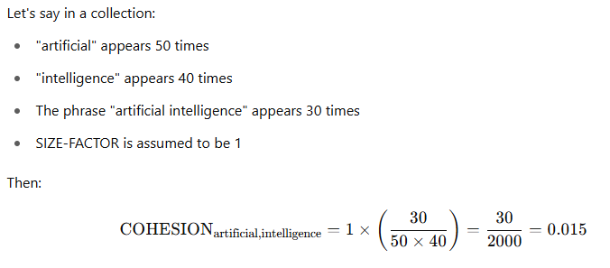
Index Phrase Generation - Example

Slide 74
Example – NLP Approach
"Industrious intelligent students":
A statistical method might find “industrious intelligent” and “intelligent student”.
NLP can detect meaningful phrases like “intelligent student” or “industrious intelligent student”.

Slide 75
NLP-Based Phrase Generation
Identifying Noun Phrases
Input: POS-tagged text
Example:
“Industrious intelligent students solve problems.”
POS tags:
Industrious: adjective
Intelligent: adjective
Students: noun
Solve: verb
Problems: noun
Resulting Phrases:
“Industrious intelligent students”
“Intelligent students”
“Students”
These are nested noun phrases, useful for indexing.

Slide 76
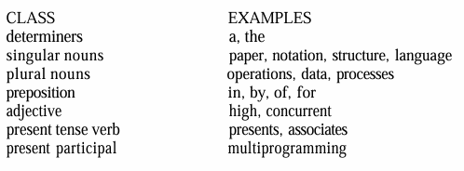
Part-of-Speech (POS)Tagging
This step finds parts of speech like nouns, verbs, adjectives.
Helps find noun phrases like “language operations” or “high performance”.

Slide 77
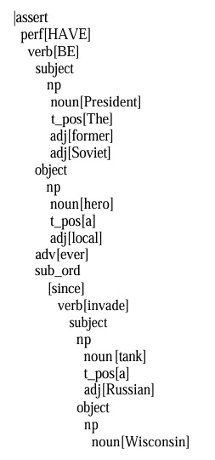
Parse Tree Structure
The parse tree figure shows the grammar structure of a sentence.
It breaks sentences into parts like subject, verb, and object, and identifies modifiers (like “russian” modifying “tank”).
The former Soviet President has been a local hero ever since a Russian tank invaded Wisconsin

Slide 78

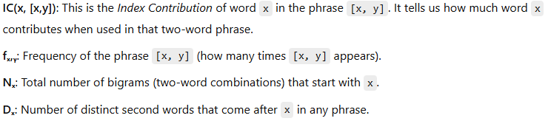
Calculating for Index Contribution (IC)
This formula measures the importance of a bigram (like [x, y]) by how often it appears, adjusted by how common x is as the first word in bigrams.

Slide 79
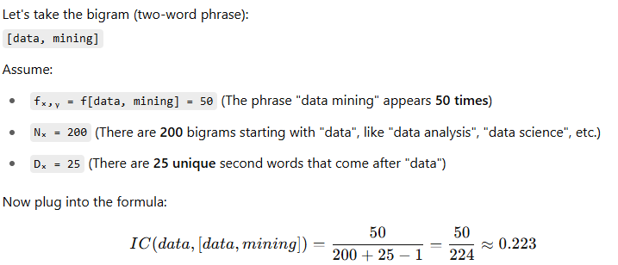
Example of Index Contribution(IC)

Slide 80
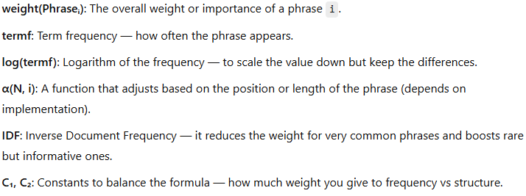
Weight of a Phrase

Slide 81
Weight of a Phrase
This formula calculates how important a phrase is by combining:
How often it appears,
Where or how it's structured,
And how unique it is across many documents.

Slide 82
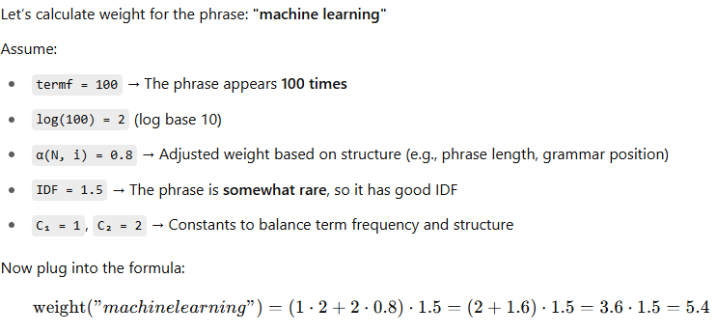
Example of Weight of a Phrase

Slide 83
Concept Indexing
Concept indexing takes the abstraction a level further. Its goal is to gain the implementation advantages of an index term system but use concepts instead of terms as the basis for the index, producing a reduced dimension vector space.
Each document is represented by terms/words.
For example:
Document A = ["car", "drive", "road"]
This method doesn't recognize that "car" and "automobile" mean the same thing.

Slide 84
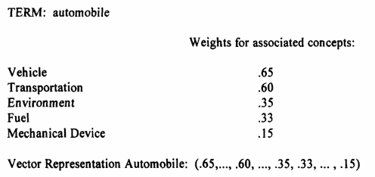
Concept Indexing
Here, we don't store raw words. Instead, we map words to concepts.

Slide 85

Concept Vectors Representation
Any rectangular matrix can be decomposed into the product of three matrices. Let X be a mxn matrix such that:
Have orthogonal columns and are m x r and r x n matrices, is an r x r diagonal matrix and r is the rank of matrix x. This is the singular value decomposition of X. The k largest singular values of are kept along with their corresponding columns in and matrices, the resulting matrix:
Is the unique matrix of rank k that is closest in least squares sense to x. The matrix containing the first k independent linear components of the original X represents the major associations with noise eliminated.

Slide 86
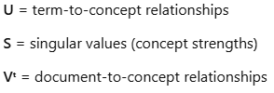
SVD (Singular Value Decomposition)
If you consider X to be the term-document matrix (e.g., all possible terms being represented by columns and each item being represented by a row), then truncated singular value decomposition can be applied to reduce the dimmensionality caused by all terms to a significantly smaller dimensionality that is an approximation of the original X:

Slide 87
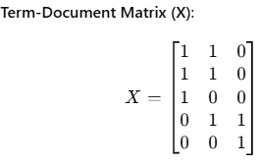
Example
we have 3 documents and 5 terms:
Term | Doc1 | Doc2 | Doc3
car | 1 | 1 | 0
automobile | 1 | 1 | 0
road | 1 | 0 | 0
mileage | 0 | 1 | 1
gas | 0 | 0 | 1

Slide 88
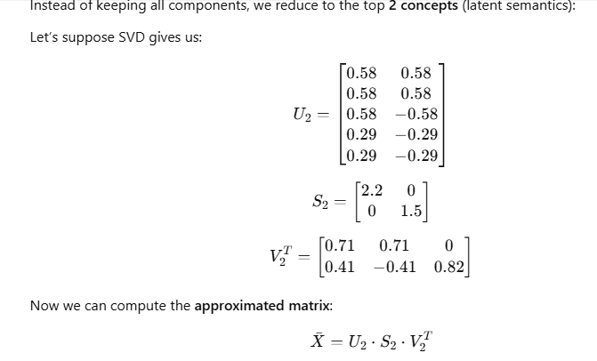

Slide 89
Hypertext Linkages
Let’s say we have a document titled "Economic Impact of Natural Disasters in Louisiana". The main body of the document discusses the financial state of Louisiana, and it includes a hyperlink to another document titled "Drought Effects on Southern States Agriculture".
Traditionally, if a user searched for “droughts in Louisiana”, this first document might not appear in the search results because the word “drought” doesn't occur explicitly in the main text — it only exists in the linked document.

Slide 90
Hypertext-Aware Indexing
Using the method proposed in the document:
The indexing algorithm recognizes the hyperlink from the Louisiana economy document to the drought impact document.
It retrieves concepts from the linked document, especially those near the hyperlink’s target section (e.g., the part about Louisiana’s drought-related crop damage).
The search index of the original Louisiana document is enriched with these concepts but with a reduced weighting (since they are not native to the original text).
When a user searches for “droughts in Louisiana”, the system now returns the Louisiana economy document as a relevant result due to its link-enhanced index.

Slide 91
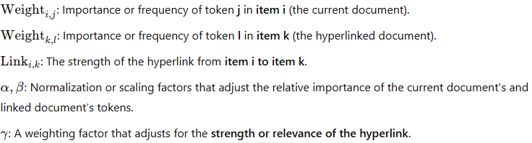
Hypertext Linkages

Slide 92
Example
Document A (item i) discusses Louisiana’s economy
Document B (item k) is linked from A and discusses drought effects in the southern states
The word "drought" appears in document B
Now, when a user searches for “droughts in Louisiana”, we want document A to appear even though it doesn't contain the word “drought” directly.

Slide 93
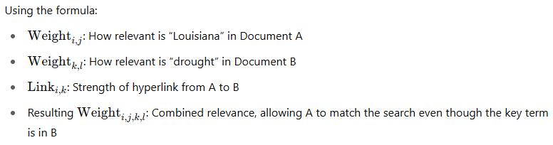
Explanation of example

Slide 94
Why do we use this formula ?
This formula mathematically represents enhanced indexing by including not only local content but also the linked context — giving rise to hypertext-aware search engines. It's a foundational idea behind more intelligent web indexing and semantic search.

Slide 95


Example

Slide 96
Introduction to Clustering
Clustering is the process of grouping similar items or terms together to improve how we search and retrieve information.
There are two main kinds:
Clustering Index Terms (Word Clustering): This creates a thesaurus — grouping similar words (e.g., synonyms). Used to improve recall by expanding queries (e.g., searching “car” also gives results for “automobile”).
Clustering Items (Document Clustering): Groups documents that are similar. Useful when a user finds one relevant document and wants more like it, even if their original query wouldn’t retrieve them.

Slide 97
Clustering Process
Define the Domain
What are we clustering?
E.g., For a medical thesaurus, only include medical terms. For document clustering, define which set of documents are used.
Select Attributes
Choose what features of the items/terms matter.
E.g., Only title/abstract of documents? Or all sections?

Slide 98
Clustering Process
Measure Relationship Strength
How related are the items/words?
E.g., How often terms co-occur? Are words synonyms?
Apply Clustering Algorithm
Based on relationships, assign items/terms to clusters.

Slide 99
Guidelines
Clear Meaning: Each cluster should have a clear semantic meaning.
Balanced Size: Clusters should be roughly equal in size.
If one cluster contains 90% of the items, it's not helpful.
No Dominance: No single term/item should dominate a cluster.
E.g., If "microprocessor" appears way more than others, maybe put it in its own cluster.
Multiple Memberships: It's better to allow an item/term to belong to multiple clusters, even if it's more complex to manage. This reflects the ambiguity of language.

Slide 100
Issues in Thesaurus Generation
Word Coordination:
Should phrases be considered (like "data mining") or only individual words?
Types of Word Relationships:
Equivalence (Synonyms): "photo" and "print"
Hierarchical: General-to-specific (e.g., "computer" → "Pentium")
Non-hierarchical: E.g., "employee" and "job title“
More recent types:
Parts-Wholes: wheel → part-of → bicycle
Collocation: words that often appear together (e.g., “coffee” and “mug”)
Paradigmatic: conceptually similar (e.g., “formula” and “equation”)

Slide 101
Issues in Thesaurus Generation
Homograph Resolution:
A homograph has multiple meanings (e.g., "field").
Systems may need users to clarify the meaning or infer it from context.
Vocabulary Constraints:
Should we store words in full or use stems?
Should we generalize terms to simplify clusters?

Slide 102
Thesaurus Generation
Thesaurus generation refers to the process of grouping similar terms together into clusters.
There are two types generation of a thesaurus
Manual Clustering
Automatic Term Clustering
Complete Term Relation Method
Clustering Using Existing Clusters
One Pass Assignments

Slide 103
Manual vs. Automatic Generation
Manual Generation (Traditional Thesauri):
Has been used for hundreds of years.
Humans manually group terms based on meanings and usage.
Useful but time-consuming and limited in scale.
Automated Generation (Statistical Clustering):
Became possible with digital texts (corpora).
Uses statistics to find groups of similar words.
These clusters don’t have names, unlike traditional thesaurus categories.
Computationally intensive to produce optimal clusters.

Slide 104
Three Basic Methods for Thesaurus Generation
Hand-Crafted Thesauri
Created manually by domain experts.
Example: A thesaurus for medical terms.
Works best in specific domains (e.g., legal, medical).
General thesauri (like WordNet) are less helpful for search and query expansion due to multiple meanings (polysemy).

Slide 105
Three Basic Methods for Thesaurus Generation
Co-Occurrence-Based Thesauri
Automatically generated based on how often words appear together in a text.
Reflects real usage in documents.
Relies on statistical methods.
Effective in capturing term similarity.

Slide 106
Three Basic Methods for Thesaurus Generation
Header-Modifier (Linguistic) Based Thesauri
Based on linguistic parsing of text.
Words are grouped based on grammatical roles they play.
Assumption: Words in similar grammatical structures are similar in meaning.
Key Syntactic Structures Parsed:
Subject-Verb (e.g., "Dogs bark")
Verb-Object (e.g., "Eat food")
Adjective-Noun (e.g., "blue sky")
Noun-Noun (e.g., "data analysis")
Co-occurrence + Mutual Information:
Each noun is associated with verbs, adjectives, and nouns it appears with.
Mutual Information (typically with a log function) measures how strongly two words are associated.
This score is used to compute similarity between words, helping in term classification.

Slide 107
Method | Key Idea | Example Use | Pros | Cons
Hand-crafted | Human-defined synonyms | Medical thesaurus | Accurate for known domains | Time-consuming, not scalable
Co-occurrence-based | Words appearing together frequently | "Apple" and "iPhone" | Reflects real usage | Needs large text data
Header-modifier based | Grammar-based word relations | "Fast car", "Slow car" | Captures linguistic similarity | Requires linguistic parsing

Slide 108
Manual Clustering
Manual clustering is a human-guided process of building a thesaurus.
Steps
Define the Domain
Generate Word List Using Concordances
Select Useful Terms
Cluster the Selected Terms
Quality Assurance

Slide 109
Manual Clustering - Steps
Define the Domain
Select the domain (e.g., data processing, medical, legal) the thesaurus is meant for.
Helps avoid homographs (same word, different meanings) and keeps terms domain-relevant.
Generate Word List Using Concordances
Use tools like:
Existing thesauri
Concordances (alphabetical list of words with frequency and document references)
Domain dictionaries

Slide 110

Manual Clustering - Steps
KWOC (Key Word Out of Context)
KWOC does not provide context—we can’t tell what kind of "chips" it is
KWIC (Key Word In Context)
Displays the term inside a sentence, showing the term with its surrounding words.
Helps resolve ambiguities (e.g., memory chips vs wood chips).
KWAC (Key Word And Context)
Displays keyword followed by full sentence context.
Easier for manual scanning of how a term is used in actual sentences.

Slide 111
Manual Clustering - Steps
Select Useful Terms:
Avoid unrelated or overly common words (like “computer” in a computer thesaurus).
Focus on domain-relevant, meaningful terms.
Cluster the Selected Terms:
Based on semantic relationships and usage patterns.
Done using editor's judgment—not automated.
Example: Group "memory", "chips", and "RAM" together if they co-occur in similar contexts

Slide 112
Manual Clustering - Steps
Quality Assurance:
Other editors review and refine the thesaurus.
Ensures accuracy, consistency, and relevance.

Slide 113
Automatic Term Clustering
“The more frequently two terms co-occur in the same items, the more likely they are about the same concept.”
Items can be documents, paragraphs, or sentences.
Terms that frequently appear together are assumed to be semantically related (talking about the same topic).

Slide 114
Techniques
Full Correlation Matrix Method
This method computes all pairwise correlations between terms.
If there are n unique words, this results in a time and computational overhead of O(n²) — meaning:
Time increases quadratically with the number of words.
It is very expensive and slow when n is large.
Iterative Clustering Method
Begins with an initial set of clusters (could be random).
Then, it iteratively reassigns terms to clusters based on similarity.
If a large number of clusters is created initially, it can be used to build higher-level clusters (a hierarchy or layered grouping).

Slide 115

Automatic Term Clustering - Complete Term Relation Method
The similarity between every term pair is calculated as a basis for determining the clusters
Using the vector model for clustering.

Slide 116

Automatic Term Clustering - Complete Term Relation Method
Each value is the dot product of two term columns across all items.
For example, to calculate SIM(Term1, Term2):
(0×4) + (3×1) + (3×0) + (0×1) + (2×2)
0 + 3 + 0 + 0 + 4 = 7
A threshold of 10 is applied. If the similarity between two terms ≥ 10, then they are considered related (marked as 1), else 0.

Slide 117



Cliques, single link, stars, String and connected components
Cliques : Cliques require all terms in a cluster to be within the threshold of all other terms

Slide 118

Single Link Clustering
Any term that is similar to any term in the cluster an be added to the cluster
It is impossible for a term to be in two different clusters

Slide 119

Star
Select a term and then places in the class all terms that are related to that term
Terms not yet in classes are selected as new seeds until all terms are assigned to a class
There are many different classes that can be created using the Star technique
If we always choose as the starting point for a class the lowest numbered term not already in a class

Slide 120

String
Starts with a term and includes in the class one additional term that is similar to the term selected and not already in a class
The new term is then used as the new node and the process is repeated until no new terms can be added because the term being analyzed does not have another term related to it or the terms related to it are already in the class
A new class is started with any terms not currently in any existing class
Using the guidelines to select the lowest number term similar to the current term and not to select any term already in an existing class produces the following classes.

Slide 121

Network Diagram of term similarities

Slide 122
Aspect | Clique | Single Link
Class Relationship Strength | Strongest relationship between all terms in a class | Weakest relationship; a term connects to at least one in the class
Concept Representation | More likely to describe a specific concept | Covers diverse/unrelated concepts
Number of Classes Produced | Produces more classes | Produces the fewest classes
Similarity Requirement | All terms must be mutually similar | Terms can be grouped even with zero similarity
Use Case (Matrix Density) | Best for dense term relationship matrices | Best for sparse term relationship matrices
Precision vs Recall | High precision – ideal for query term expansion | High recall – may retrieve more non-relevant items
Computational Overhead | Higher (not specified, but more complex due to full linkage requirement) | Lower overhead – only O(n²) comparisons
Use in Thesaurus Construction | Suitable when concept clarity is critical | Suitable when broad coverage is desired

Slide 123
Automatic Term Clustering - Clustering Using Existing Clusters - approach using centroids and iterations.
In this method:
We start with arbitrary cluster assignments (i.e., randomly grouping terms).
We calculate centroids (average vector of terms in a cluster).
Then, each term is re-evaluated for similarity with each centroid.
The term is reassigned to the cluster with the highest similarity.
This process is repeated iteratively until minimal or no movement happens.

Slide 124

Step 1: Initial Cluster Centroids (Figure 6.6b)
Black squares = initial centroids.
Triangles = terms.
Circles = initial groupings of terms into 3 clusters (Classes 1, 2, 3).
At this stage, the centroids are arbitrarily placed and do not accurately represent the final clusters yet.

Slide 125

Step 2: After Reassignment (Figure 6.6a)
After the first iteration of recalculating centroids and reassigning terms, we see:
The black squares have moved closer to actual clusters.
Terms are more appropriately grouped.
Still not perfect, but closer to ideal.

Slide 126

Step 3: Centroid Calculations (Image of Class 1, 2, 3)
Class 1 = (Term 1 and Term 2),
Class 2 = (Term3 and Term 4) and Class 3 = (Term5 and Term 6).

Slide 127
Step 4: First Iteration of Term Assignment
 | Term1 | Term2 | Term3 | Term4 | Term5 | Term6 | Term7 | Term8
Class 1 | 29/2 | 20/2 | 24/2 | 27/2 | 17/2 | 32/2 | 15/2 | 24/2
Class 2 | 31/2 | 20/2 | 38/2 | 45/2 | 12/2 | 34/2 | 6/2 | 17/2
Class 3 | 28/2 | 21/2 | 22/2 | 24/2 | 17/2 | 30/2 | 11/2 | 19/2
Assign | C2 | C1 | C2 | C2 | C3 | C2 | C1 | C1
This table shows the similarity between each term (Term1 to Term8) and the centroids of the 3 classes
Based on which class gives the highest similarity score, terms are reassigned.
Note: Ties like Term 5 are resolved by choosing the class that best matches most of its dimensions.

Slide 128
Step 5: New Centroids
 | Term1 | Term2 | Term3 | Term4 | Term5 | Term6 | Term7 | Term8
Class 1 | 23/3 | 45/3 | 16/3 | 27/4 | 15/3 | 36/3 | 23/3 | 34/3
Class 2 | 67/4 | 45/4 | 70/4 | 78/4 | 33/4 | 72/4 | 17/4 | 40/4
Class 3 | 12/1 | 3/1 | 6/1 | 6/1 | 11/1 | 6/1 | 9/1 | 3/1
Assign | C2 | C1 | C2 | C2 | C3 | C2 | C3 | C1
After new assignments, centroids are recalculated again. These are based on the new groups of terms
Only Term 7 moved from Class 1 to Class 3, which makes sense because:
Its similarity to Class 1 was weak.
It’s closer to Class 3’s centroid now.

Slide 129
Key Observation
Computation overhead: O(n)
The number of classes is defined at the start of the process and cannot grow – It is possible to be fewer classes at the end of the process
Since all terms must be assigned to a class, it forces terms to be allocated to classes, even if their similarity to the class is very weak compared to other terms assigned

Slide 130
Automatic Term Clustering - One Pass Assignments
It's a very fast clustering method where:
Each term (like a word or document) is processed only once.
There's no iteration like in k-means.
Clusters are formed on the fly based on a similarity threshold.

Slide 131
Step-by-Step Process
Start with Term 1
Automatically assign it to Class 1 (because it’s the first one).
For each next term, do:
Compare it to the centroid of each existing class.
If the highest similarity is greater than or equal to the threshold (e.g., 10), assign it to that class.
Otherwise, create a new class and assign the term there.
After assigning a term to a class, update that class's centroid (average of vectors of its members).

Slide 132
Example Centroid Calculations
Class 1 = Term 1, Term 3, Term 4
Class 2 = Term 2, Term 6, Term 8
Class 3 = Term 5
Class 4 = Term 7

Slide 133
Example Centroid Calculations
Term1: (0, 4, 3, 0, 2)
Term3: (0, 3, 0, 1, 2)
Centroid = (0+0)/2, (4+3)/2, (3+0)/2, (0+1)/2, (2+2)/2
= (0, 7/2, 3/2, 0.5, 2)
Term4: (0, 3, 0, 2, 3)
New Centroid = (0+0+0)/3, (4+3+3)/3, (3+0+0)/3, (0+1+2)/3, (2+2+3)/3
= (0, 10/3, 1, 1, 7/3)
Similarly for Class 2:
After Term2 & Term6:
Term2: (6, 1, 0, 0, 3)
Term6: (0, 2, 0, 1, 3)
Centroid = (6+0)/2, (1+2)/2, (0+0)/2, (0+1)/2, (3+3)/2
= (3, 1.5, 0, 0.5, 3)

Slide 134
Characteristics of One Pass Assignment
Pros:
Very fast → O(n) time complexity.
No need to specify number of clusters beforehand.
Great for streaming data or massive datasets.
Cons:
Order-sensitive: the final clusters depend on the order of terms.
Doesn’t guarantee optimal clusters.
Once assigned, terms don’t move—even if a better cluster forms later

Slide 135
Item Clustering
Think about manual item clustering, which is inherent in any library or filing system – one item one category
Automatic clustering – one primary category and several “secondary” categories
Similarity between documents is based on two items that have terms in common – The similarity function is performed between rows of the item matrix

Slide 136
Step 1:Calculating Similarity
Formula measures similarity between two items by computing the dot product of their term vectors.
Term_{i,k} ​: Term weight or count of term k in Item i
If two items share many common terms (or the same terms with high weight), their similarity is high.

Slide 137

Step 2: Item/Item Similarity Matrix Step 3: Item Relationship Matrix
Higher number → greater similarity.
For example: Item 2 and Item 5 have similarity 36 (strong connection).
We apply a threshold (e.g., 10):
If similarity ≥ 10 → assign 1
Else → assign 0
This results in a binary matrix (Figure 6.10) representing item relationships.

Slide 138
Step 4: Clustering Methods
Clique Algorithm:
Finds fully connected subgroups.
Class 1: Items 1, 2, 5
Class 2: Items 2, 3
Class 3: Items 2, 4, 5 Note: Items can belong to multiple cliques.
Single Link Algorithm:
Builds a single cluster by linking items that are indirectly connected.
Class 1: All Items → [1, 2, 5, 3, 4]
Because:
Item 1 → Item 2 → Item 3 & 5 → Item 4
All linked through at least one neighbor.

Slide 139
Step 4: Clustering Methods
Star Algorithm:
Starts with the lowest unassigned item as the center.
Class 1: Item 1, 2, 5
Class 2: Item 3, 2
Class 3: Item 4, 2, 5
Each star has a center with its directly connected items.
String Algorithm:
Creates chains of items until all are assigned.
Class 1: Items 1, 2, 3
Class 2: Items 4, 5
Grows clusters by connecting the next available unassigned item.

Slide 140

Step 5: Clustering with Centroids
Instead of using relationships, now use term vectors to create centroids (average vectors of each class).
Initial Assignment:
Class 1: Items 1 & 3
Class 2: Items 2 & 4
Compute Centroids (Averages of Item Vectors)
Example:
Class 1 Centroid = (Item 1 + Item 3) / 2
Class 2 Centroid = (Item 2 + Item 4) / 2
Then compare each item's vector to both centroids, and reassign it based on higher similarity.

Slide 141
Hierarchy of Clusters
Hierarchical Clustering builds a tree-like structure (called a dendrogram) of clusters based on the similarity or distance between data points (documents or terms).
Hierarchical agglomerative clustering (HAC) – start with un-clustered items and perform pair-wise similarity measures to determine the clusters.
Hierarchical divisive clustering – start with a cluster and breaking it down into smaller clusters
There are two main approaches:
Agglomerative (Bottom-up): Start with each item in its own cluster and successively merge the most similar pairs.
Divisive (Top-down): Start with one big cluster and divide it into smaller ones.

Slide 142
Objectives of Creating a Hierarchy of Clusters :
Reduce the overhead of search
Perform top-down searches of the centroids of the clusters in the hierarchy and trim those branches that are not relevant
Provide for visual representation of the information space
Visual cues on the size of clusters (size of ellipse) and strengths of the linkage between clusters (dashed line, sold line…)
Expand the retrieval of relevant items
A user, once having identified an item of interest, can request to see other items in the cluster
The user can increase the specificity of items by going to children clusters or by increasing the generality of items being reviewed by going to a parent clusters

Slide 143

Dendogram for Visualizing Hierarchical Clusters
This figure visually represents a hierarchical cluster tree:
Each ellipse at the bottom is a document/item.
As you go up, similar items are merged into clusters.
The height at which two clusters are joined reflects their dissimilarity.
Dendrograms help users:
Visually explore clusters.
Navigate from general to specific information.

Slide 144

Cluster Similarity: Lance-Williams Formula

Slide 145


Ward's Method (Variance-Based)
This is a minimum variance method, where:
The goal is to minimize the increase in total within-cluster variance.

Slide 146
Monolithic vs Polythetic Clusters
Monolithic: Clusters are formed based on a single attribute; easier to interpret (e.g., Yahoo directories).
Polythetic: Based on multiple features like terms and concepts; harder to interpret but more flexible.

Slide 147

Concept Hierarchy with Term Subsumption (Sanderson & Croft)
If 80% of the documents containing term Y also contain term X → X is a more general concept than Y.
This builds a concept hierarchy where:
Parent = more general term
Child = more specific term
Represented as a directed acyclic graph (DAG)

Slide 148
Semantic Hierarchies and Thesauri
Manual thesauri use semantic relationships (e.g., is-a, part-of).
Automatic clustering can build item hierarchies effectively.
However, for term hierarchies, automation often introduces errors, so human-guided construction is more reliable.

Slide 149
Component | Explanation
Dendrogram | Tree diagram showing how documents/items are hierarchically clustered
HACM | Hierarchical Agglomerative Clustering Methods used to group similar documents
Lance-Williams Formula | General formula to update cluster distances
Ward’s Method | Minimizes variance within clusters
Subsumption Rule | Defines parent-child relationship in term hierarchies
Centroids | Mean vector of items in a cluster; used to cluster at higher levels
Scatter/Gather | IR technique using repeated clustering
Monolithic vs Polythetic | Monolithic: simple, one-topic clusters; Polythetic: multi-attribute, harder to interpret

